Slide 1
Welcome To Our Presentation

Slide 2
Research Topic
On Weather Forecasting Using Machine Learning Algorithms

Slide 3
Supervised by
Ms. Maksuda Rabeya
Lecturer
Dept. of Computer Science and Engineering
Southeast University

Slide 4



TEAM MEMBERS
Ibrahim
ID:2017000000117
Department of CSE
Southeast University
Jobaer Bhuiyan
ID:2017000000144
Department of CSE
Southeast University
Abul Khair
ID:2017100000008
Department of CSE
Southeast University

Slide 5
Contents
Research Analysis
Introduction
Pros and Cons
Literature Review
Research Objective
Methodology
Implementation
Result And Discussion
Algorithms
Future Extension
Conclusion

Slide 6
RESEARCH ANALYSIS
IDEA
FUTURE EXTENSION
DATA
IMPLEMENTATION
RESEARCH
ALGORITHMS
CALCULATION
CLASSIFICATION
RESULT

Slide 7
Introduction
Since ancient times, weather forecasting has been one of the most interesting and challenging area. One of the important fields of weather forecasting is rainfall prediction which is important for food production plan and water resource management. Bangladesh is an agricultural country and most of its economy depends upon the agriculture.
We aimed to predict the average temperature of Bangladesh in this research paper. As a subtropical country, Bangladesh has very different weather from other countries due to periodic disparities of rainfall, sophisticated temperatures, and humidity. Mainly three distinct seasons are present in Bangladesh, and those are Summer, Rainy, and Winter.
Weather Forecasting Using Machine Learning Algorithms

Slide 8
Pros and cons
Contribution of the research:
Climatology and weather forecasting is important since it helps determine future climate expectations. Through the use of latitude, one can determine the likelihood of snow and hail reaching the surface. We can also identify the thermal energy from the sun that is accessible to a region.
Benefits of the research:
No matter what carrier field we’re in or how up we’re , there’s always more to learn. In others, it may not be absolutely necessary, but it has many benefits.
Research expands our knowledge base.
Research gives us the latest information.
Research builds our credibility.
Research help with problem solving.
Research introduces us to new ides.
Weather Forecasting Using Machine Learning Algorithms

Slide 9
Literature review(con.)
This paper investigates some researches in the prediction domain we have done. Literature survey plays a very important role in the project development. Literature review provides the required knowledge about the project and its background. It also helps in following the best practices in project development.
Here author concludes that for representations of knowledge discovery, decision trees are fast to execute, very accurate, and best be desired. Classification tasks are adapted by many experts in their own domains and are used by many researchers in various different applications. For constructing more reliable decision trees, multi-tree approaches are the best .
The author says we can predict the average temperature for the future month if we have the relevant data with a certain degree of accuracy.
Weather Forecasting Using Machine Learning Algorithms

Slide 10
Literature review
Different classifications like Linear regression, Decision Trees and Random forest. Linear regression has achieved quite promising performance among the algorithms. Among the classification Algorithms decision tree has achieved promising results compared to other algorithms. The predicted outcomes are 80% of accuracy.
Chauhan and Jawahar Thakur (2013) made a comparison in their paper, which shows that the algorithms is linear regression are well suited for mining data to predict future weather conditions.
Weather Forecasting Using Machine Learning Algorithms

Slide 11
Research objective
As changes in weather conditions depend on many small factors, using different factors, e.g. temperature, humidity, precipitation, wind speed, etc., will help predict the weather conditions more accurately.
Comparing the results of these hybrid machine learning algorithms to develop the best possible algorithm to predict the weather.
This research aims to find the most efficient and accurate machine learning model to predict weather updates for a specific region.
Weather Forecasting Using Machine Learning Algorithms

Slide 12
Methodology
We have a problem statement which comes under the category of Classification. It is a multiclass classification in which the classes given to us are.
Our aim is to classify the given data into the above given classes. In order to do so, we have to first analyze the data given to us.
This model can be: Linear regression, Logistic Regression, SVM, Neural Networks, Decision Tress, K-Nearest Neighbors etc. Parameter tuning can also be done in order to increase our accuracy.
We Collect a level www.visualcrossing.com that contained news articles on Weather Forecasting from .
Weather Forecasting Using Machine Learning Algorithms

Slide 13
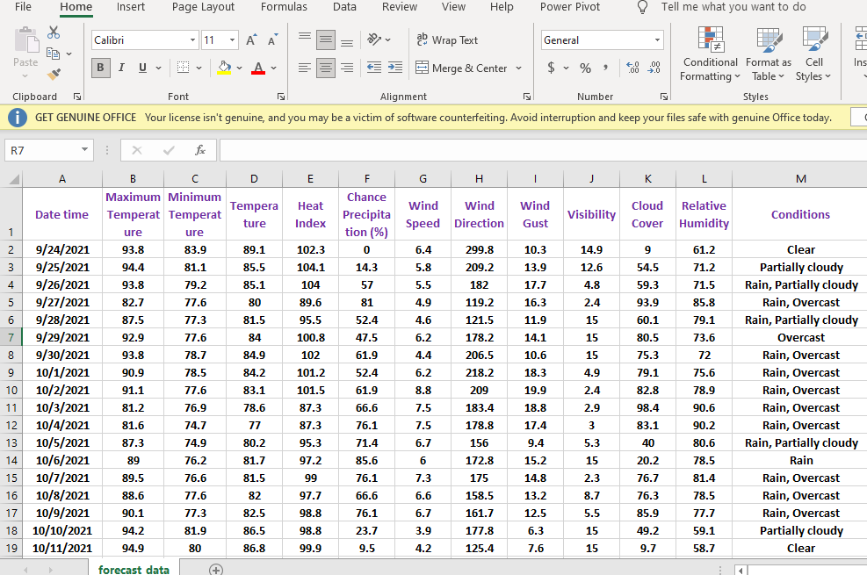
Data Set
Fig-1: weather Forecasting Data Set
Weather Forecasting Using Machine Learning Algorithms

Slide 14
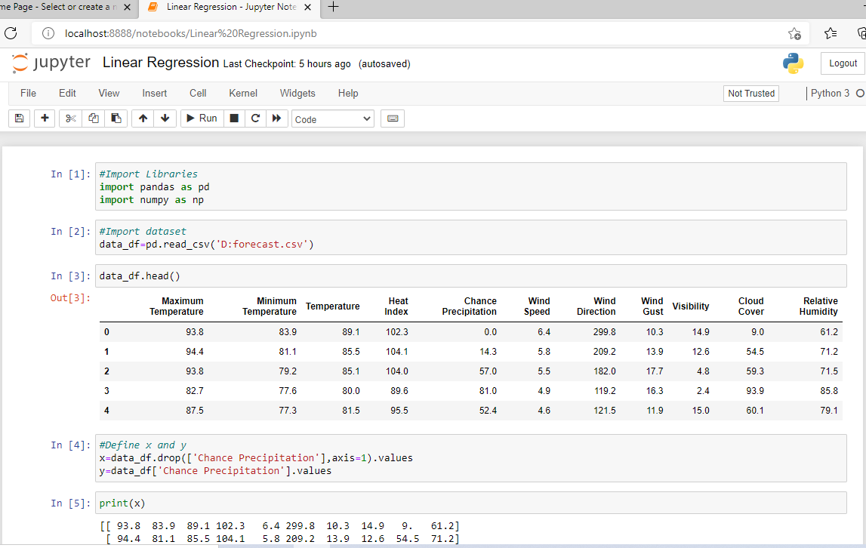
Implementation(con.)
Import Libraries & Data
Fig-2: Import libraries & data
Weather Forecasting Using Machine Learning Algorithms

Slide 15
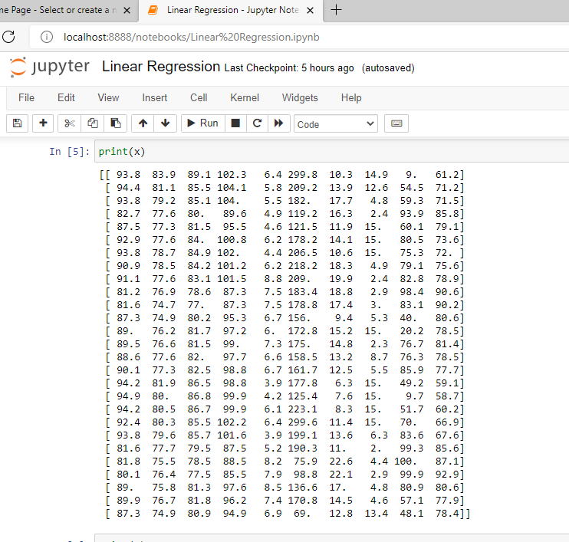

Implementation(con.)
Define x & y:
Fig-3: Define x values
Weather Forecasting Using Machine Learning Algorithms

Slide 16
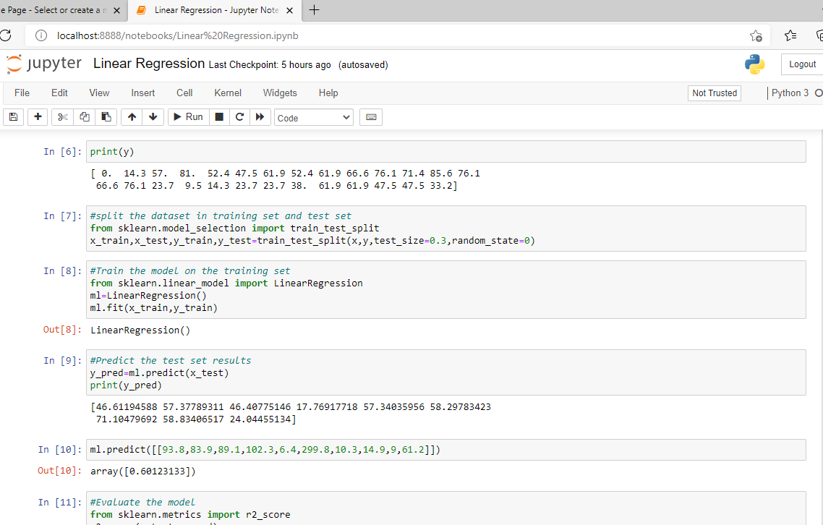
Implementation(con.)
Model the training set & Predict the test set results:
Fig-4:Model the training set & Predict the test set results
Weather Forecasting Using Machine Learning Algorithms

Slide 17
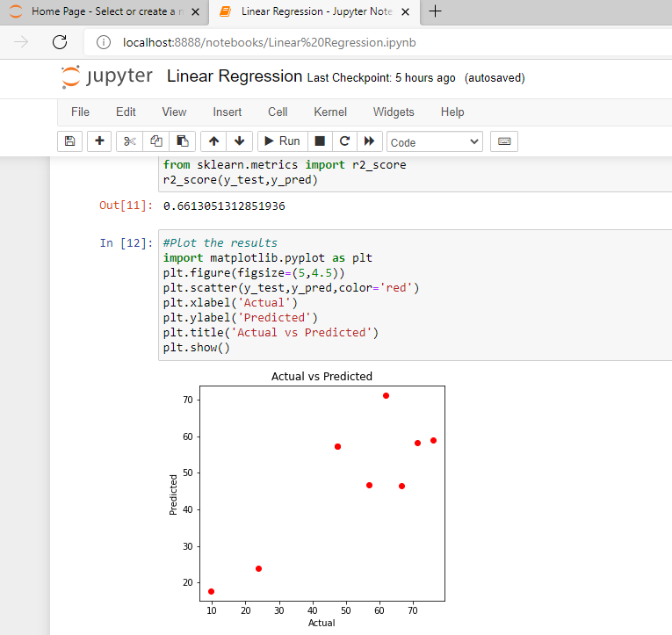
Implementation(c0n.)
Evaluate the model & Plot the result:
Fig-5: Evaluate the model & Plot the result
Weather Forecasting Using Machine Learning Algorithms

Slide 18
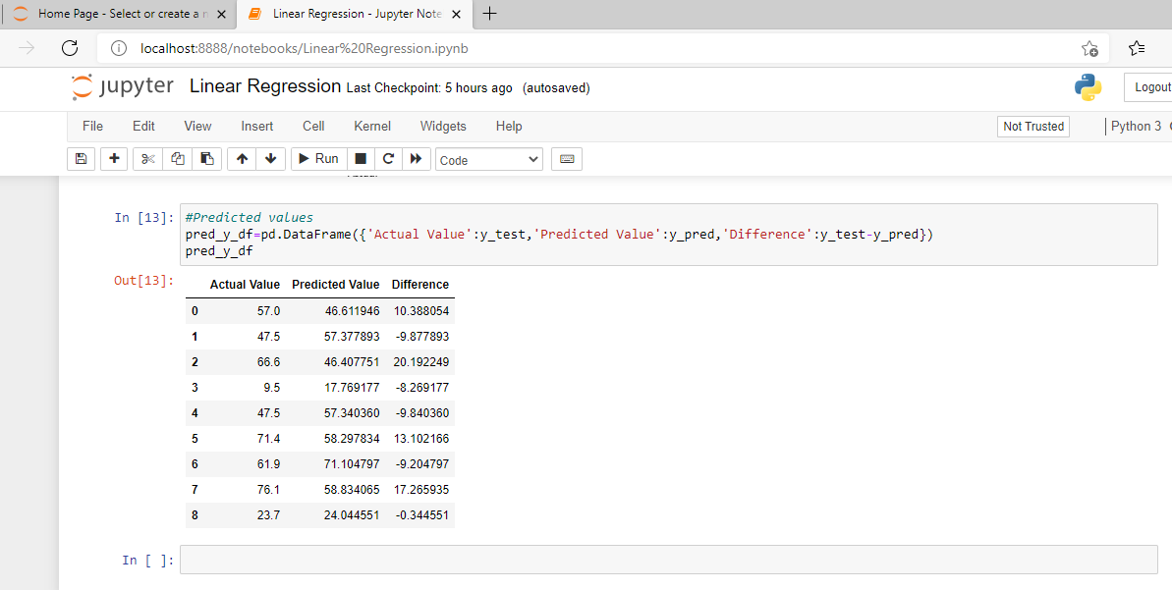
Implementation
Predicted Values Output & Difference:
Fig-6:Predicted values output & Difference
Weather Forecasting Using Machine Learning Algorithms

Slide 19
Result and discussion
Using the above linear regression algorithm, we can do the calculation of linear regression as follows.
We have tested and evaluated the linear regression model on the rainfall dataset and the accuracy of the model is 0.066%.Further we will apply the multiple linear regression model to find the accuracy of the model on the dataset.
Using the above algorithm we have further shown the difference in predicted value from actual value.
Weather Forecasting Using Machine Learning Algorithms

Slide 20
ALGORITHMS
Linear Regression:
Linear regression is a simple technique for supervised learning which works on structural as well as time series data. It is the assumption that the dependency of Y on X1, X2, X3 is linear.
Multiple linear regression:
Multiple linear regression (MLR), also known simply as multiple regression, is a statistical technique that uses several explanatory variables to predict the outcome of a response variable. The goal of multiple linear regression is to model the linear relationship between the explanatory (independent) variables and response (dependent) variables. In essence, multiple regression is the extension of ordinary least-squares (OLS) regression because it involves more than one explanatory variable.
Weather Forecasting Using Machine Learning Algorithms

Slide 21
FUTURE EXTENSION
We plan to extended this research by integrating part of Speech tagging to reduce the false-positive results so that the model can perform more efficiently.
This model can be deployed into any web server by training with more data
so that everyone can use it to find weather forecasting related authentic news
from a website.
The ideas we have gained through research on weather forecasting can be used in various future projects.
Weather Forecasting Using Machine Learning Algorithms

Slide 22
CONCLUSIONS
In this area of global warming, research in weather measurement, monitoring and forecasting are becoming more and more relevant.
Weather Forecasting plays an important role in human life, so the collection of information about the temporal dynamics of weather changes is very paramount.
This research demonstrates the design and Implementation of an affordable mini weather monitoring system that ensures portability, scalability and user friendly operations which can provide data of some weather variables including temperature, humidity, wind speed, wind direction with real time data. It was calculated using the linear regression formula.
Weather Forecasting Using Machine Learning Algorithms

Slide 23
REFERENCES
Weather Data Online. (2021). Bangladesh. Retrieved from https://www.visualcrossing.com/weather/weather-data-services#/viewData
Beni, S. &Arora, J. (2012), ―Classification and feature selection techniques in data mining‖, International Journal of Engineering Research & Technology (IJERT), 1(6)
Kumar, R., & Khatri, R. (2016). A Weather Forecasting Model using the Data Mining Technique. International Journal of Computer Applications, 139(14).
A Quick Review of Machine Learning Algorithms, 2019, International Conference on Machine Learning, Big Data, Cloud and Parallel Computing.
A Quick Review of Machine Learning Algorithms, 2019, International Conference on Machine Learning, Big Data, Cloud and Parallel Computing.
https://www.ripublication.com/ijaer19/ijaerv14n4_12.pdf
http://live.bmd.gov.bd/
Weather Forecasting Using Machine Learning Algorithms

Slide 24
THANK
YOU

